Slide 1
Hướng Dẫn Cách “Reset Default” Camera IP Của DSS_Dahua Bằng Phần Cứng (IPC Hardware Instruction)
2017

Slide 2
IPC 8 Series
2017

Slide 3
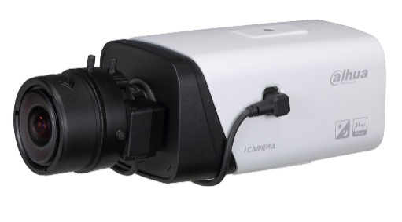
HF81230/81200/8281E
Serial port
Reset: Press the reset button for 5 seconds.
Serial port connection: Please use connector(1.2.17.12.0011) and weld it on the package of the serial port.
Reset
2017

Slide 4
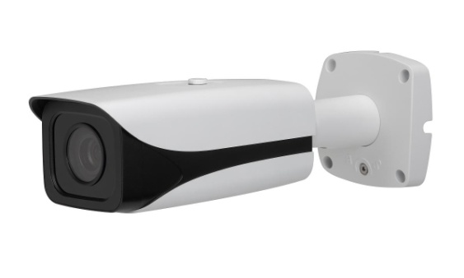
HFW81230/81200/8630/8331/8281/8231/8232E-Z
Reset: Press the reset button for 5 seconds.
Serial port connection: Please use connector(1.2.17.12.0011) and weld it on the package of the serial port.
Serial port
Reset
2017

Slide 5
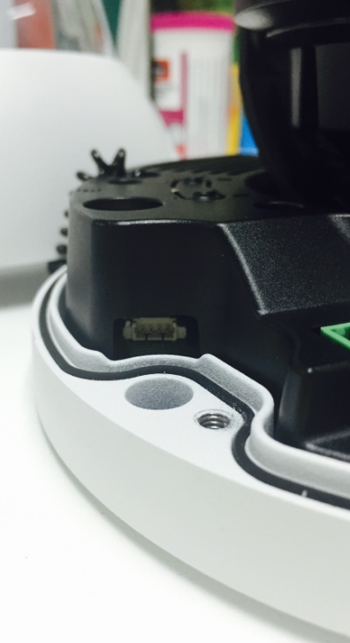
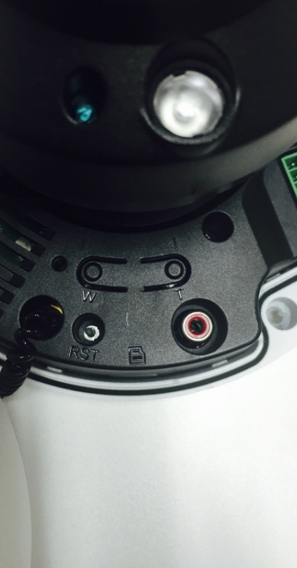
HDBW81230/81200/8630/8331/8281 /8231/8232E-Z
Reset: Press the reset button for 5 seconds.
Serial port connection: Please use connector(1.2.17.12.0011) and weld it on the package of the serial port.
Serial port
Reset
2017

Slide 6
IPC 5 Series
2017

Slide 7
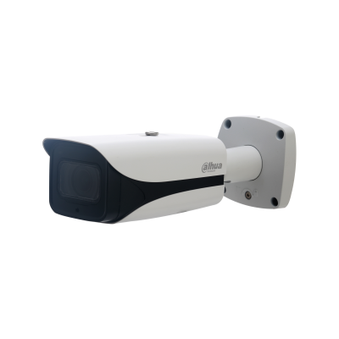
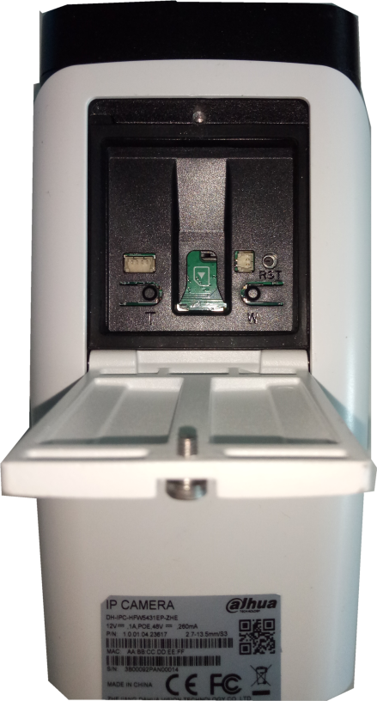
HFW5231/5431/5631/5831E-ZE(Z5E)
SD Card
Reset: Press the reset button for 5 seconds.
Serial port connection: Please use connector(1.2.17.12.0011) and weld it on the package of the serial port.
Serial port
Reset
2017

Slide 8
HFW5231E-Z12E
SD Card
Reset: Press the reset button for 5 seconds.
Serial port connection: Please use connector(1.2.17.12.0011) and weld it on the package of the serial port.
Serial port
Reset
2017

Slide 9
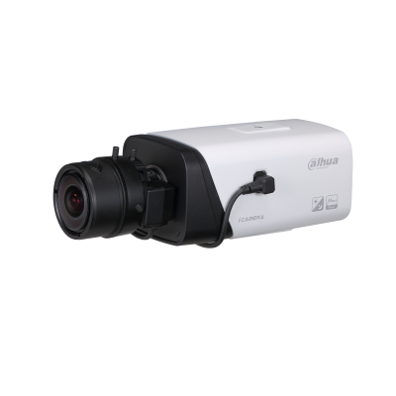
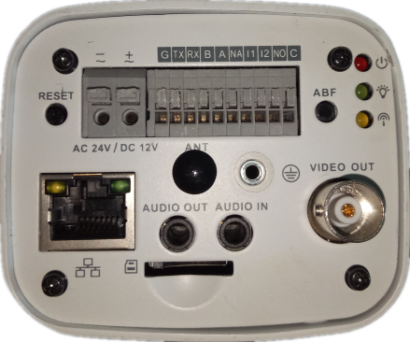
HF5231/5431E-E
Serial port
Reset: Press the reset button for 5 seconds.
Serial port connection: Please use connector(1.2.17.12.0011) and weld it on the package of the serial port.
Reset
SD Card
2017

Slide 10
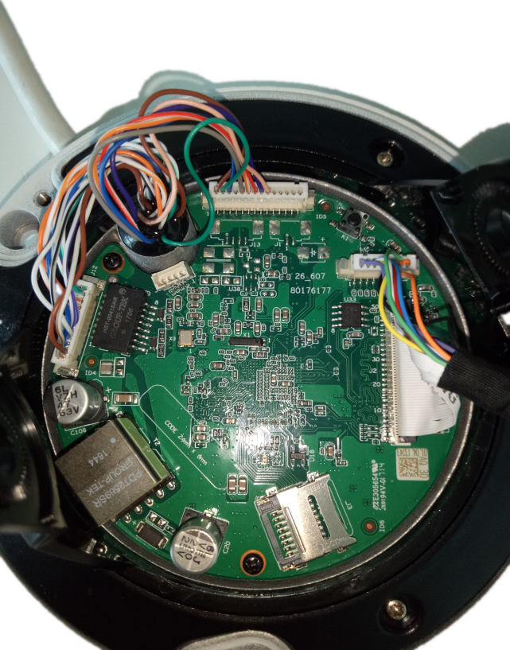
HDBW5231/5431/5631/5831R-ZE
Reset
Reset: Press the reset button for 5 seconds.
Serial port connection: Please use connector(1.2.17.12.0011) and weld it on the package of the serial port.
Serial port
SD Card
2017

Slide 11
HDBW5231/5431/5631/5831E-ZE(Z5E)
Reset: Press the reset button for 5 seconds.
Serial port connection: Please use connector(1.2.17.12.0011) and weld it on the package of the serial port.
Serial port
Reset
2017

Slide 12
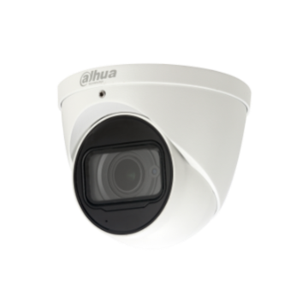
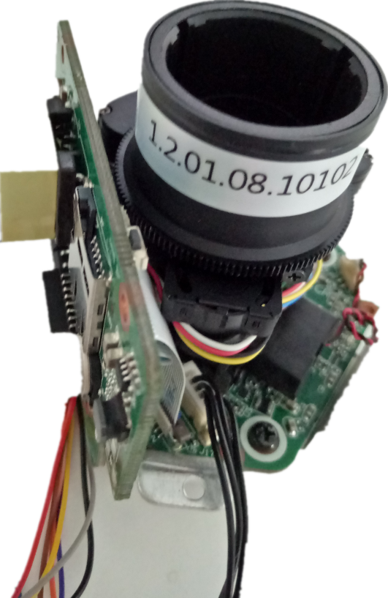
HDW5231/5431/5631/5831R-ZE
Reset: Press the reset button for 5 seconds.
Serial port connection: Please use connector(1.2.17.12.0011) and weld it on the package of the serial port.
Reset
SD Card
2017

Slide 13
IPC 4 Series
2017

Slide 14
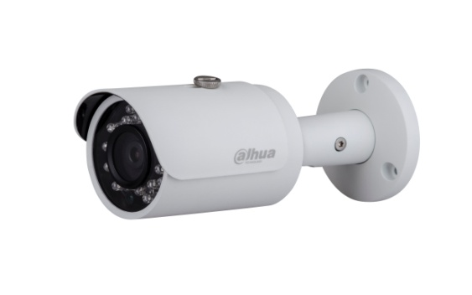
HFW4421/4221/4220/4120S
Reset: Make short circuit between two small holes on the PCB for 5 seconds.
Serial port connection: Please use connector(1.2.17.12.0011) and weld it on the package of the serial port.
Reset
Serial port
2017

Slide 15
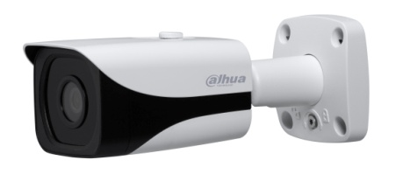
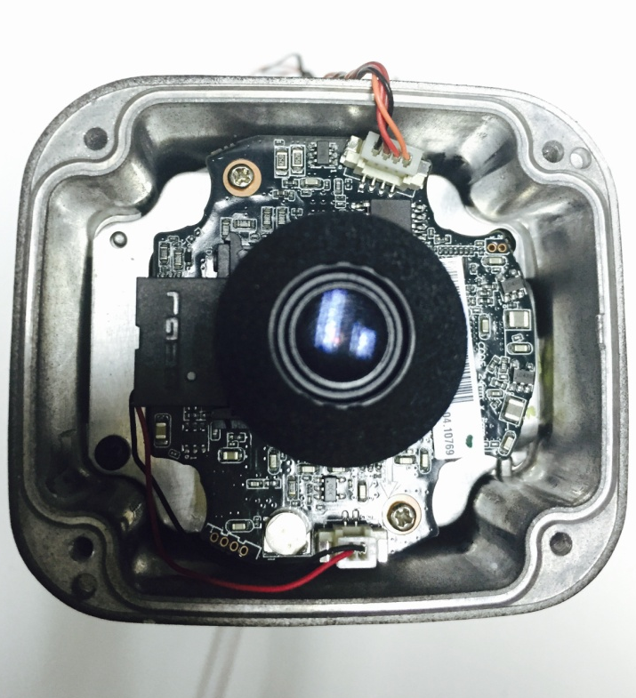
HFW4421/4221/4220/4120E
Reset
Reset: Make short circuit between two small holes on the PCB for 5 seconds.
Serial port connection: Please use connector(1.2.17.12.0011) and weld it on the package of the serial port.
Serial port
2017

Slide 16
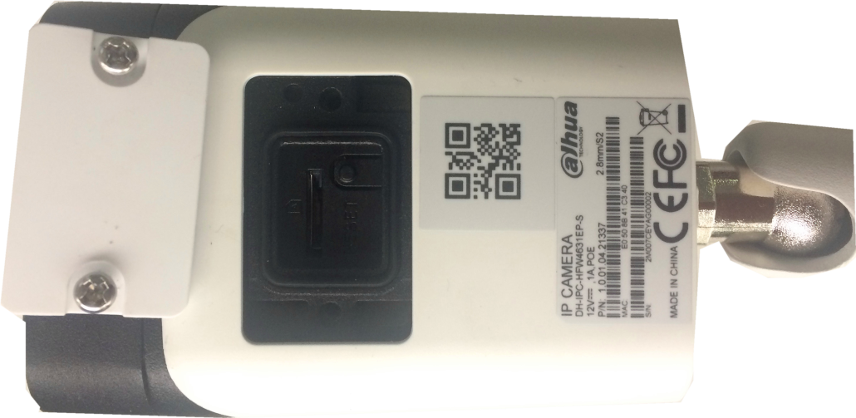
HFW4830/4431/4231E-S
Reset: Press the button for 5 seconds.
Serial port connection: Please use connector(1.2.17.12.0011) and weld it on the package of the serial port.
Reset
SD Card
2017

Slide 17
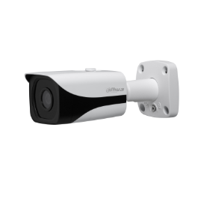
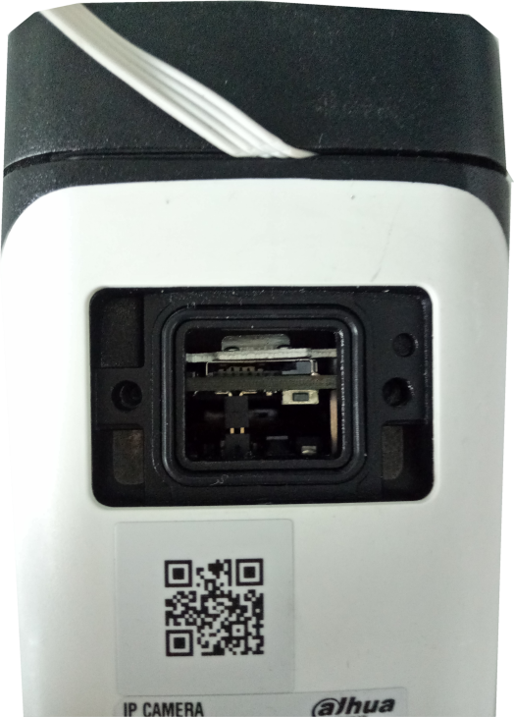
HFW4231/4431/4631/4831E-SE
Reset: Press the reset button for 5 seconds.
Serial port connection: Please use connector(1.2.17.12.0011) and weld it on the package of the serial port.
Reset
2017

Slide 18
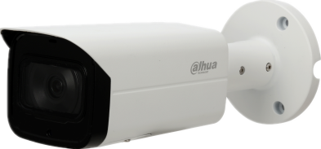
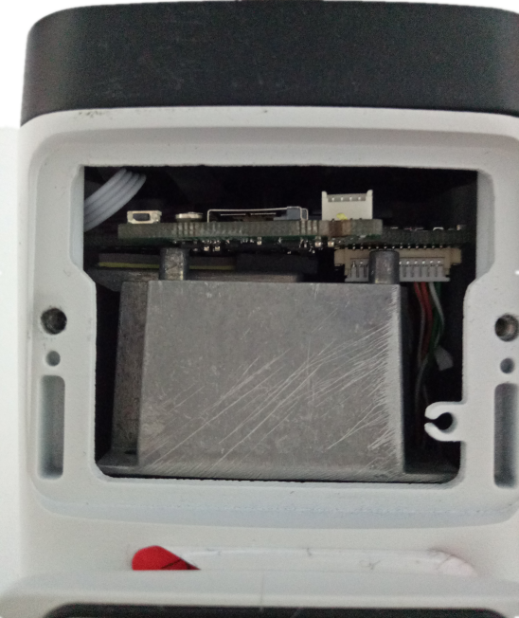
HFW4231/4431/4631/4831T-ASE
Reset: Press the reset button for 5 seconds.
Serial port connection: Please use connector(1.2.17.12.0011) and weld it on the package of the serial port.
Reset
Serial port
SD Card
2017

Slide 19
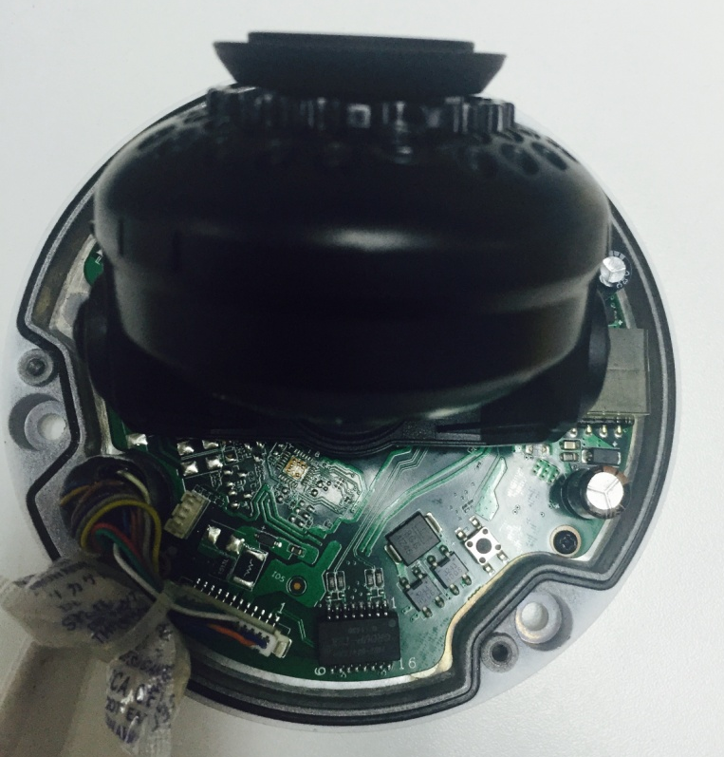
HDBW4421/4221/4220/4120/4830/4431/4231E-AS
Reset: Press the reset button for 5 seconds.
Serial port connection: Please use connector(1.2.17.12.0011) and weld it on the package of the serial port.
Serial port
Reset
2017

Slide 20
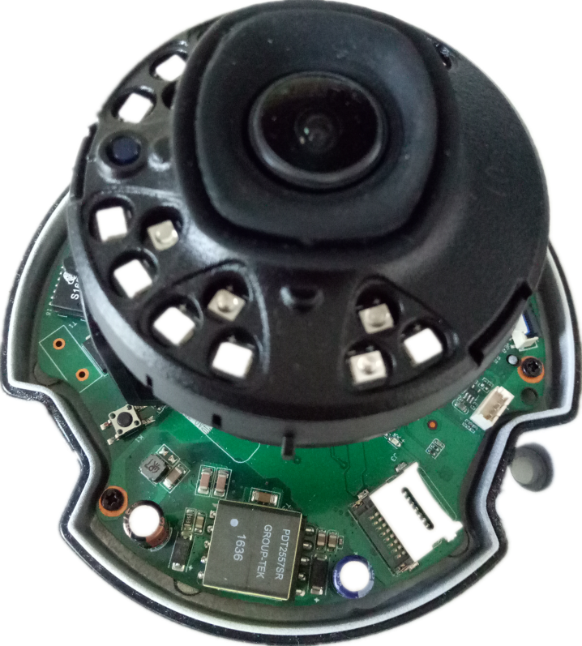
HDBW4231/4431/4631/4831E-ASE
Reset: Press the reset button for 5 seconds.
Serial port connection: Please use connector(1.2.17.12.0011) and weld it on the package of the serial port.
Reset
Serial port
SD Card
2017

Slide 21
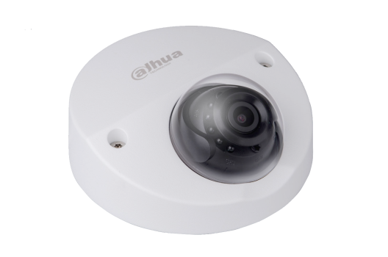
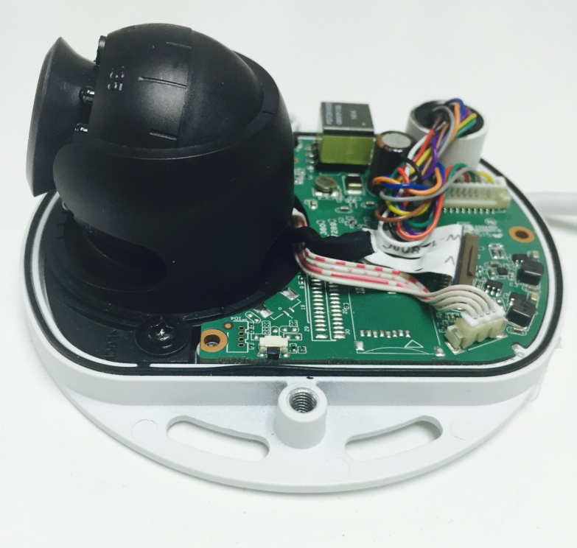
HDBW4421/4221/4220/4120F
Reset: Press the reset button for 5 seconds.
Serial port connection: Please use connector(1.2.17.12.0011) and weld it on the package of the serial port.
Serial port
Reset
2017

Slide 22
HDBW4431/4231F-AS
Reset: Press the reset button for 5 seconds.
Serial port connection: Please use connector(1.2.17.12.0011) and weld it on the package of the serial port.
Serial port
Reset
2017

Slide 23
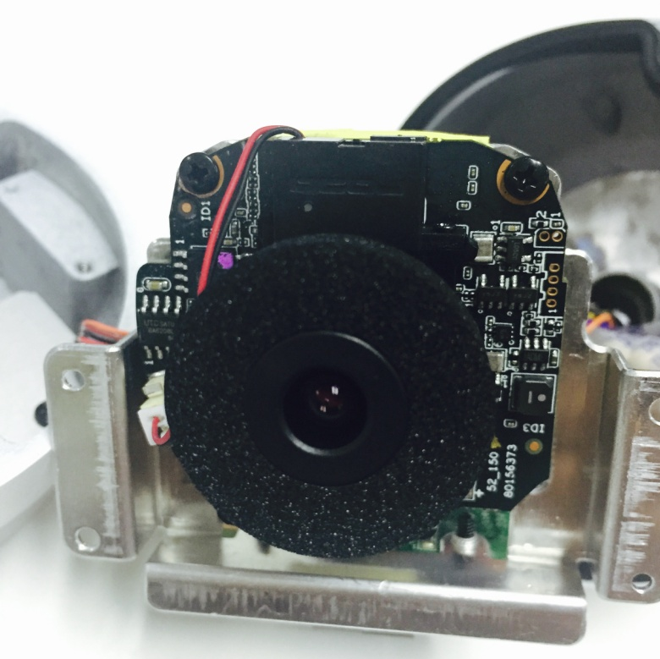
HDW4421/4221/4220/4120E
Reset
Reset: Make short circuit between two small holes on the PCB for 5 seconds.
Serial port connection: Please use connector(1.2.17.12.0011) and weld it on the package of the serial port.
Serial port
2017

Slide 24
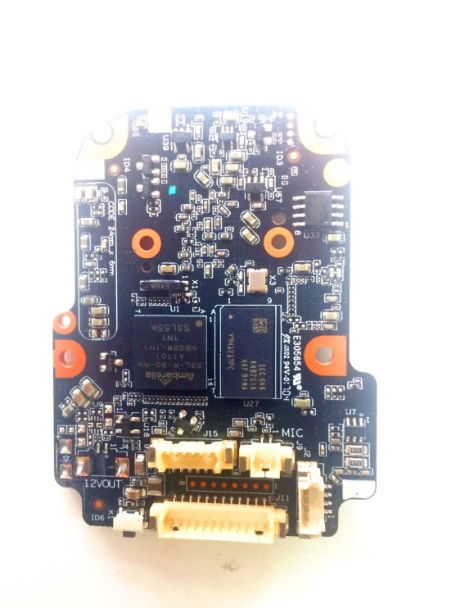
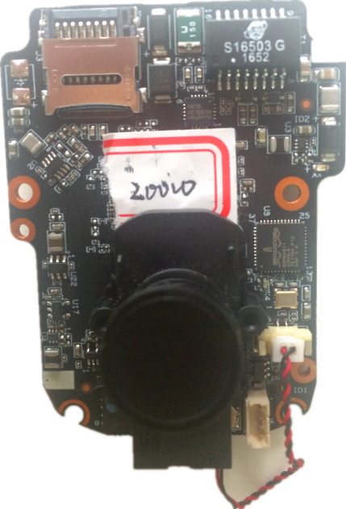
HDW4830/4431/4231EM-AS
SD Card
Reset: Press the reset button for 5 seconds.
Serial port connection: Please use connector(1.2.17.12.0011) and weld it on the package of the serial port.
Serial Port
Reset
正面
反面
2017

Slide 25
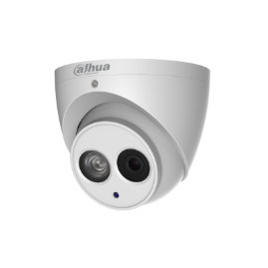
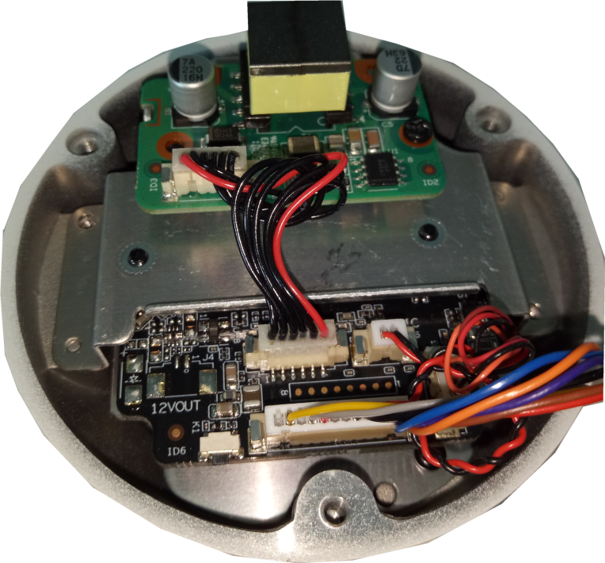
HDW4231/4431/4631/4831EM-ASE
Reset: Press the reset button for 5 seconds.
Serial port connection: Please use connector(1.2.17.12.0011) and weld it on the package of the serial port.
Reset
2017

Slide 26
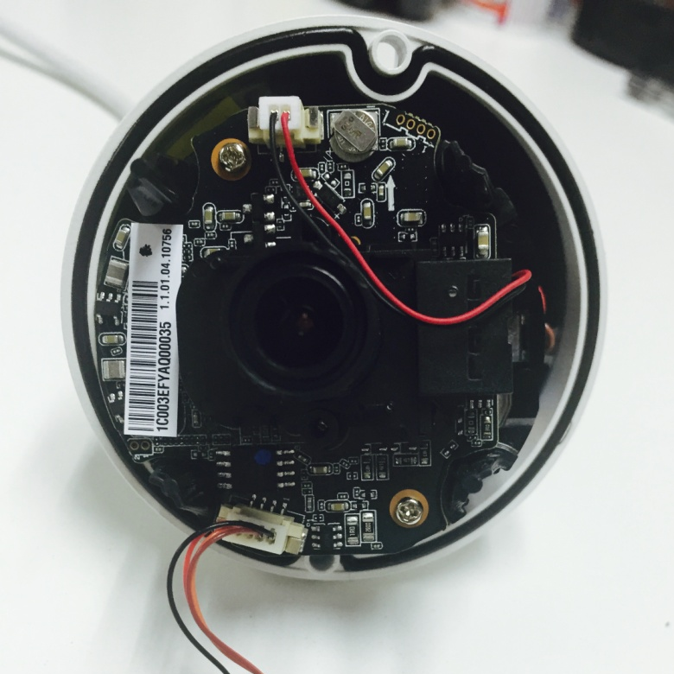
HDW4431/4231/4421/4221/4220/4120M
Serial port
Reset: Make short circuit between two small holes on the PCB for 5 seconds.
Serial port connection: Please use connector(1.2.17.12.0011) and weld it on the package of the serial port.
Reset
2017

Slide 27
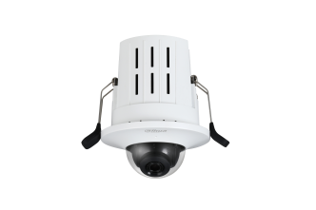
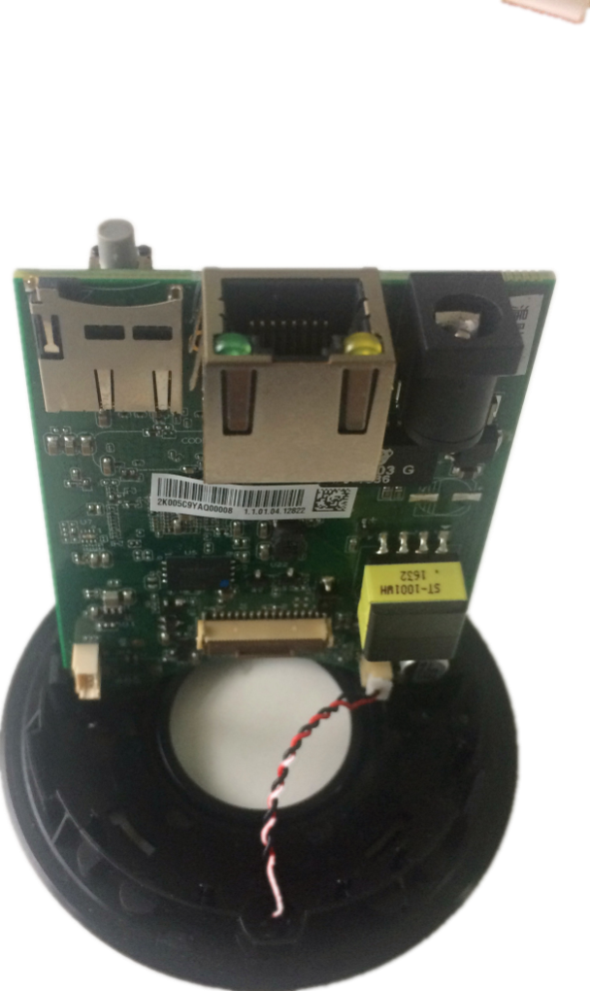
HDB4231/4431G-AS
Reset
Reset: Press the reset button for 5 seconds.
Serial port connection: Please use connector(1.2.17.12.0011) and weld it on the package of the serial port.
SD Card
Serial port
2017

Slide 28
IPC 2 Series
2017

Slide 29
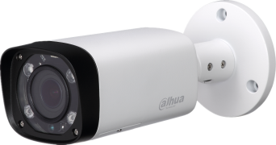
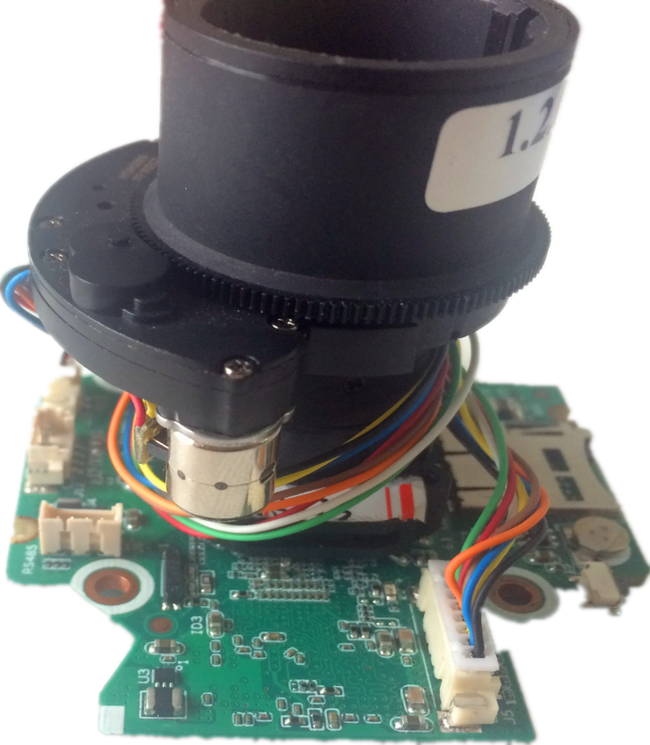
HFW2230/2320/2221/2121R-VFS/ZS
Reset: Press the reset button for 5 seconds.
Serial port connection: Please use connector(1.2.17.12.0011) and weld it on the package of the serial port.
SD Card
Serial Port
Reset
2017

Slide 30
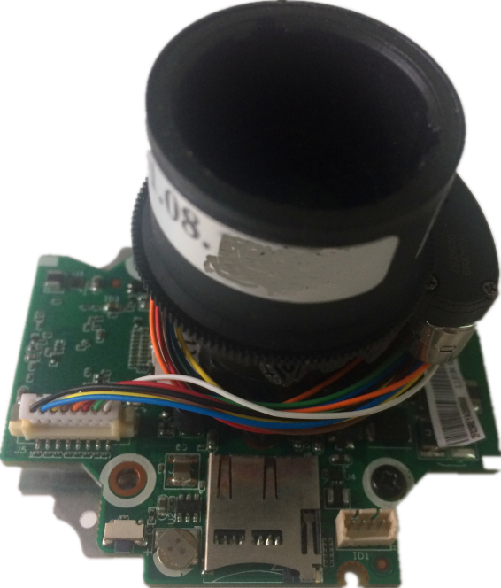
HFW2231/2431R-VFS/ZS
Reset: Press the reset button for 5 seconds.
Serial port connection: Please use connector(1.2.17.12.0011) and weld it on the package of the serial port.
SD Card
Serial Port
Reset
2017

Slide 31
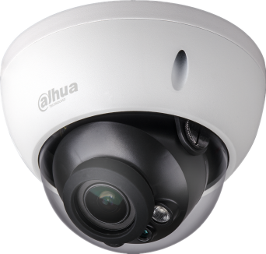
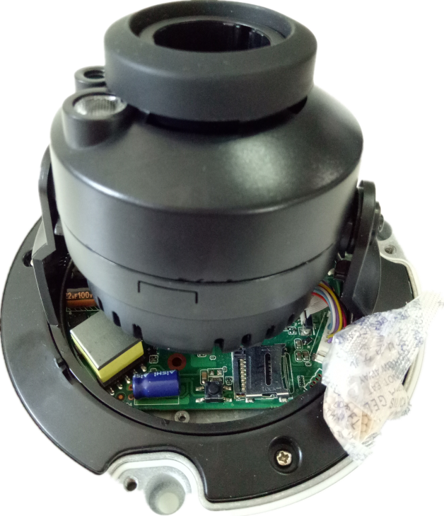
HDBW2431/2231/2230/2320/2221/ 2121R-VFS/ZS
Reset: Press the reset button for 5 seconds.
Serial port connection: Please use connector(1.2.17.12.0011) and weld it on the package of the serial port.
Reset
SD Card
2017

Slide 32
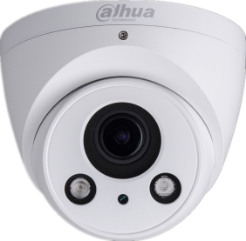
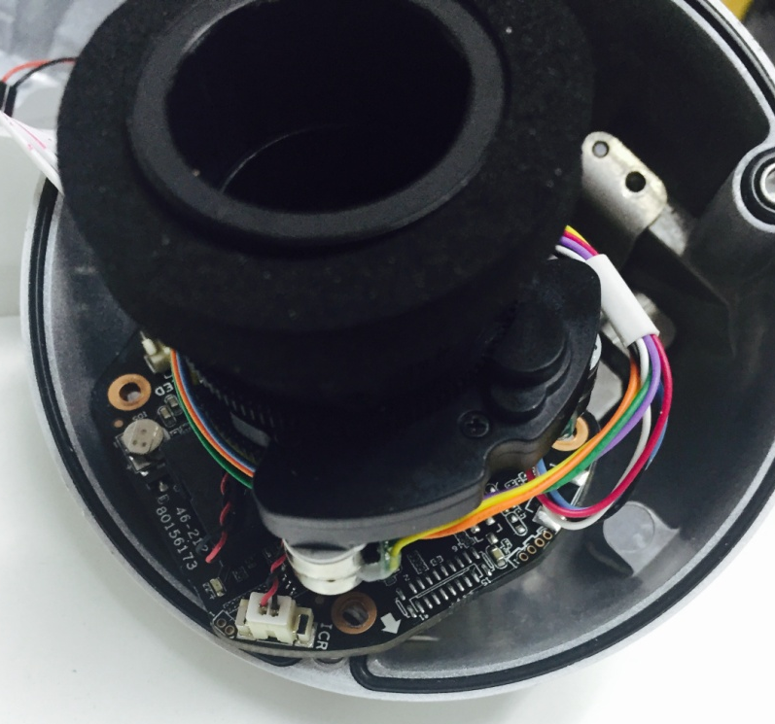
HDW2320/2221/2121R-Z
Reset: Make short circuit between two small holes on the PCB for 5 seconds.
Serial port connection: Please use connector(1.2.17.12.0011) and weld it on the package of the serial port.
Serial port
Reset
2017

Slide 33
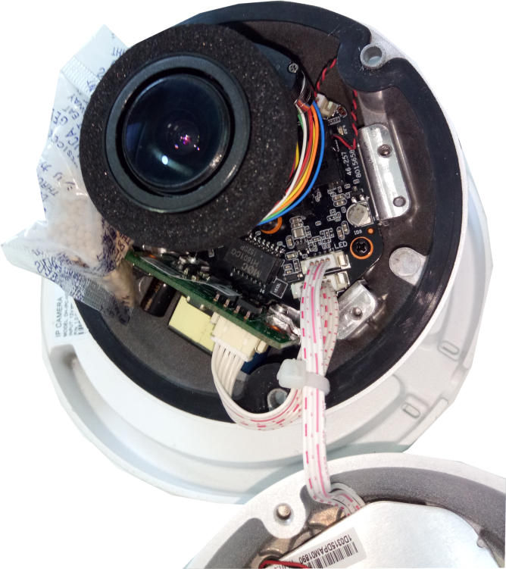
HDW2230/2231/2431R-ZS/VFS
Reset
Reset: Make short circuit between two small holes on the PCB for 5 seconds.
Serial port connection: Please use connector(1.2.17.12.0011) and weld it on the package of the serial port.
2017

Slide 34
IPC 1 Series
2017

Slide 35
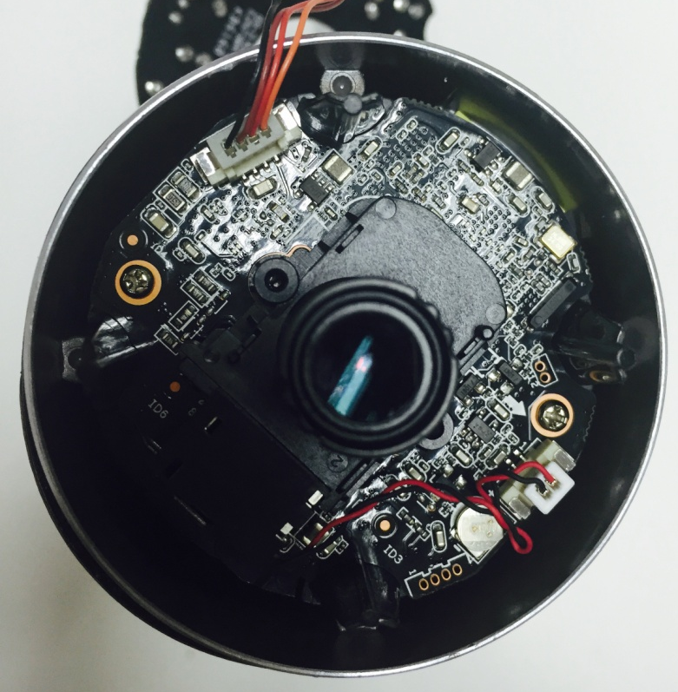
HFW1320/1220/1120/1020S
Reset: Press the reset button for 5 seconds.
Serial port connection: Please use connector(1.2.17.12.0011) and weld it on the package of the serial port.
Reset
Serial port
2017

Slide 36
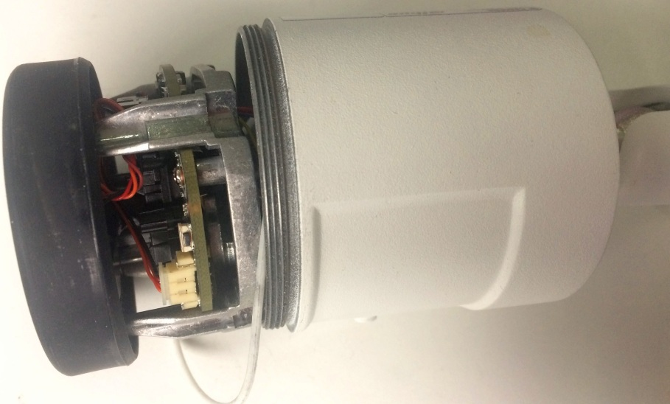
HFW1431/1230S
Reset: Press the reset button for 5 seconds.
Serial port connection: Please use connector(1.2.17.12.0011) and weld it on the package of the serial port.
Reset
2017

Slide 37
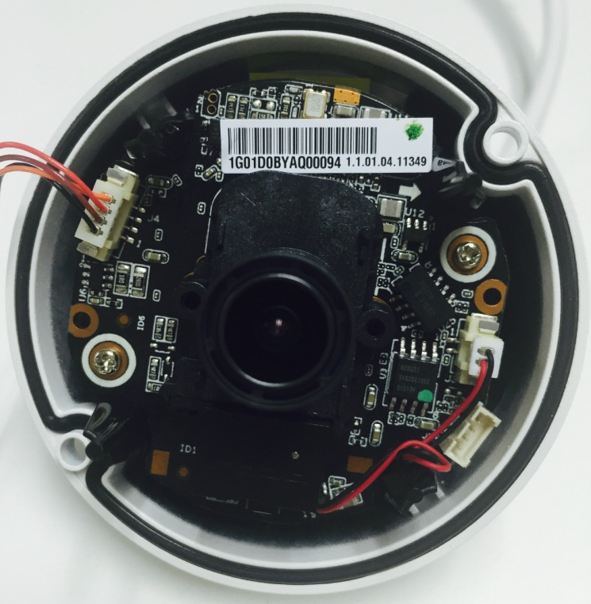
HDW1320/1220/1120/1020S
Reset
Reset: Make short circuit between two small holes on the PCB for 5 seconds.
Serial port connection: Please use connector(1.2.17.12.0011) and weld it on the package of the serial port.
Serial port
2017

Slide 38
HDW1431/1230S
Reset
Reset: Make short circuit between two small holes on the PCB for 5 seconds.
Serial port connection: Please use connector(1.2.17.12.0011) and weld it on the package of the serial port.
Serial port
2017

Slide 39
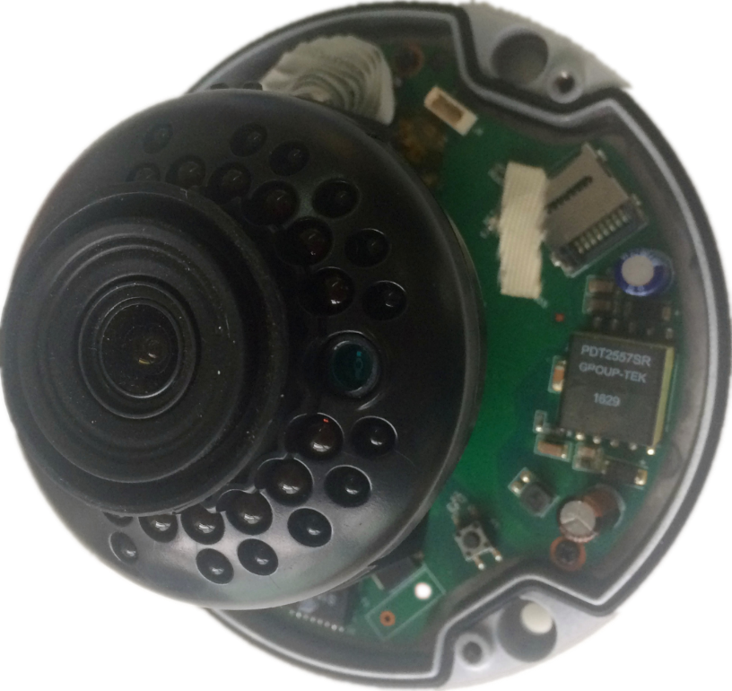
HDBW1230E（-S）/1431E（-S）/1320E
Serial Port
Reset: Press the reset button for 5 seconds.
Serial port connection: Please use connector(1.2.17.12.0011) and weld it on the package of the serial port.
SD Card
Reset
2017

Slide 40
THANKS!
DSS_Dahua Việt Nam
2017

